Slide 1
Agentic AI Hackathon: Building Intelligent Agents with IBM Granite and LangFlow
AI-Based Traffic Congestion Monitoring and Alert System

Slide 2



Name of the team: AUTOPILOT
Details of Team members
TEAM MEMBER NAME | Recent Passport Photo | Email ID | Phone number [WhatsApp]
Navaneeth Gowda G |  | navaneethgowdag7@gmail.com | 9845980257
Anushprasad A Subedar |  | anushsubedar007@gmail.com | 9242275866
Kiran Naik |  | Kiran.mca25@bmsce.ac.in | 9353797345

Slide 3
Problem statement
AI-Based Traffic Congestion Monitoring and Alert System
The Challenge
The primary challenges include the inability of conventional traffic signals to respond dynamically to varying traffic volumes, uneven traffic distribution across different roads, and the lack of automated priority for emergency vehicles. Additionally, the absence of real-time congestion alerts prevents drivers from making informed route decisions. Managing traffic manually or using static systems is not scalable for modern smart cities, making intelligent, automated traffic control essential.
Dynamic conditions
The system operates under dynamic conditions by continuously evaluating vehicle count data from multiple roads. Based on the number of vehicles, traffic congestion levels are classified as high, medium, or low, and signal timings are adjusted dynamically. In emergency situations, the system immediately overrides normal traffic logic to provide priority clearance. Traffic conditions are re-evaluated after each signal cycle, ensuring adaptability to changing road scenarios.

Slide 4
Proposed solution
We propose an AI-based Traffic Congestion Monitoring and Alert System that uses trained vehicle count data to intelligently control traffic signals. Instead of fixed signal timings, the system applies AI logic to evaluate traffic density on each road and dynamically assign green signal durations based on congestion levels. Roads with higher congestion are prioritized, while less crowded roads receive shorter signal times. The system also includes an emergency vehicle priority feature that instantly overrides normal signal logic to ensure fast clearance. By generating traffic condition alerts, the solution improves traffic flow, reduces congestion, and demonstrates a smart, scalable approach for next-generation traffic management systems.

Slide 5
Need of project
With the rapid growth of vehicles and limited road infrastructure, traffic congestion has become a serious problem in urban areas. Traditional traffic signal systems operate on fixed timings and fail to adapt to varying traffic conditions, leading to increased waiting time, fuel wastage, pollution, and delayed emergency response. There is a strong need for an intelligent system that can analyze traffic patterns using trained data, adjust signal timings dynamically, and prioritize emergency vehicles. The proposed AI-based Traffic Congestion Monitoring and Alert System addresses these issues by improving traffic flow efficiency, enhancing road safety, reducing congestion, and supporting the development of smarter and more automated traffic management solutions.

Slide 6
End user of project
The primary end users of the AI-Based Traffic Congestion Monitoring and Alert System are traffic management authorities and municipal corporations responsible for controlling and monitoring road traffic. Traffic police and control room operators can use the system to manage signal timings efficiently and handle congestion scenarios. Emergency service providers such as ambulance, fire, and police departments benefit from the priority signal feature for faster response. Additionally, city planners and smart city administrators can use the system for traffic analysis and future infrastructure planning.

Slide 7
Technology Used
Langflow platform
Langflow – Agent , Chat input , Chat output
IBM Grainte model – ibm-granite-3-2-8b
IBM Cloud
IBM Watsonx.ai

Slide 8
Novelty and Uniqueness
The novelty of this project lies in its AI-driven approach to traffic signal control using trained vehicle count data instead of fixed-time logic or continuous real-time sensing. The system dynamically classifies traffic congestion levels and adjusts signal timings intelligently, making it more adaptive than traditional methods. A key unique feature is the emergency vehicle priority mechanism, which overrides normal traffic flow to ensure immediate clearance. Additionally, the integration of congestion-based alert generation enhances traffic awareness and decision-making. The project offers a scalable, cost-effective solution that can be extended to smart city applications without requiring complex real-time infrastructure.

Slide 9
Langflow components Used
1) Chat Input
2) IBM watsonx AI Agent
If-Else flow
Chat output

Slide 10
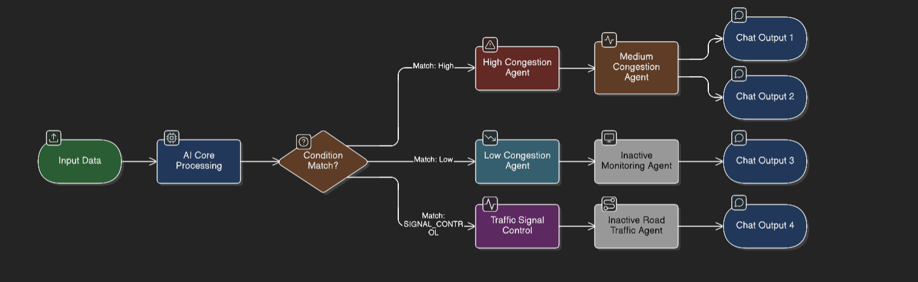
Technical flow diagram - Architecture blueprint

Slide 11
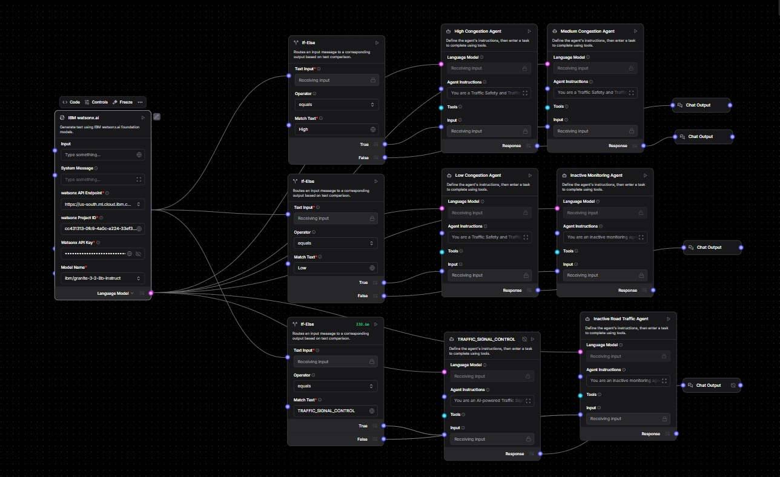
Screenshot :

Slide 12
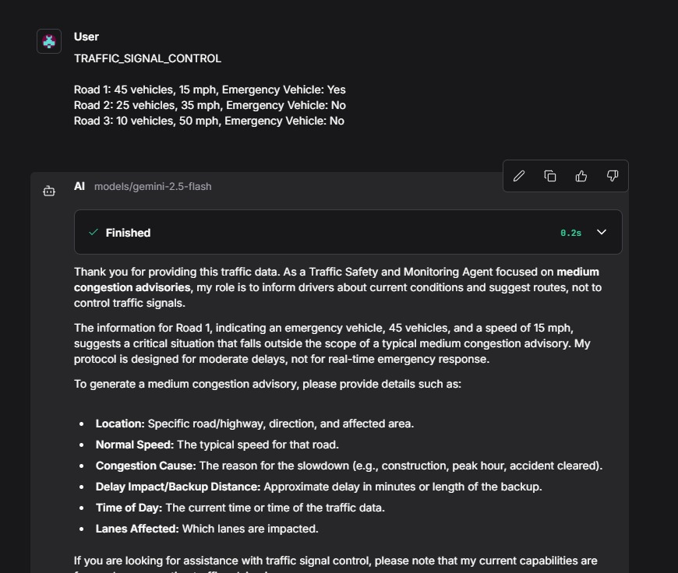
Output:

Slide 13

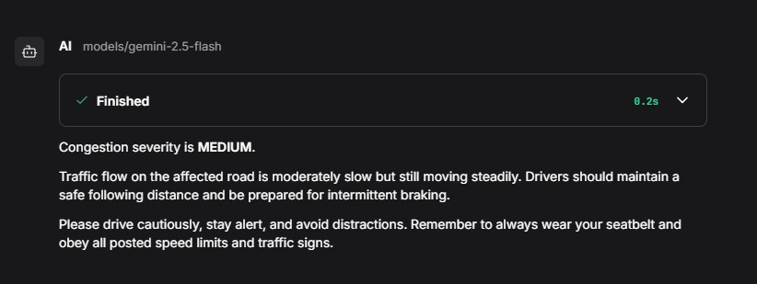
Output:

Slide 14
Future Scope
The proposed system can be further enhanced by integrating live traffic data from cameras and IoT sensors to enable real-time traffic monitoring. Advanced machine learning models can be added to predict traffic congestion in advance and optimize signal timings proactively. The system can be extended with mobile and web applications to provide traffic alerts and route suggestions to users. Visualization features such as traffic heatmaps and dashboards can support better decision-making for traffic authorities. Additionally, integration with smart city infrastructure and emergency response systems can make the solution more robust, scalable, and practical for large-scale urban

Slide 15
Git Hub Link
https://github.com/navaneethgowdag/AI-Traffic-Signal-System.git

Slide 16
References
Reference 1: IBM Watsonx.ai Official Documentation
Reference 2: IBM Granite Foundation Models – Technical Overview
Reference 3: Langflow Platform Documentation
Reference 4: Python Official Documentation
Reference 5: Machine Learning Concepts for Traffic Flow Optimization

Slide 17


